Slide 1
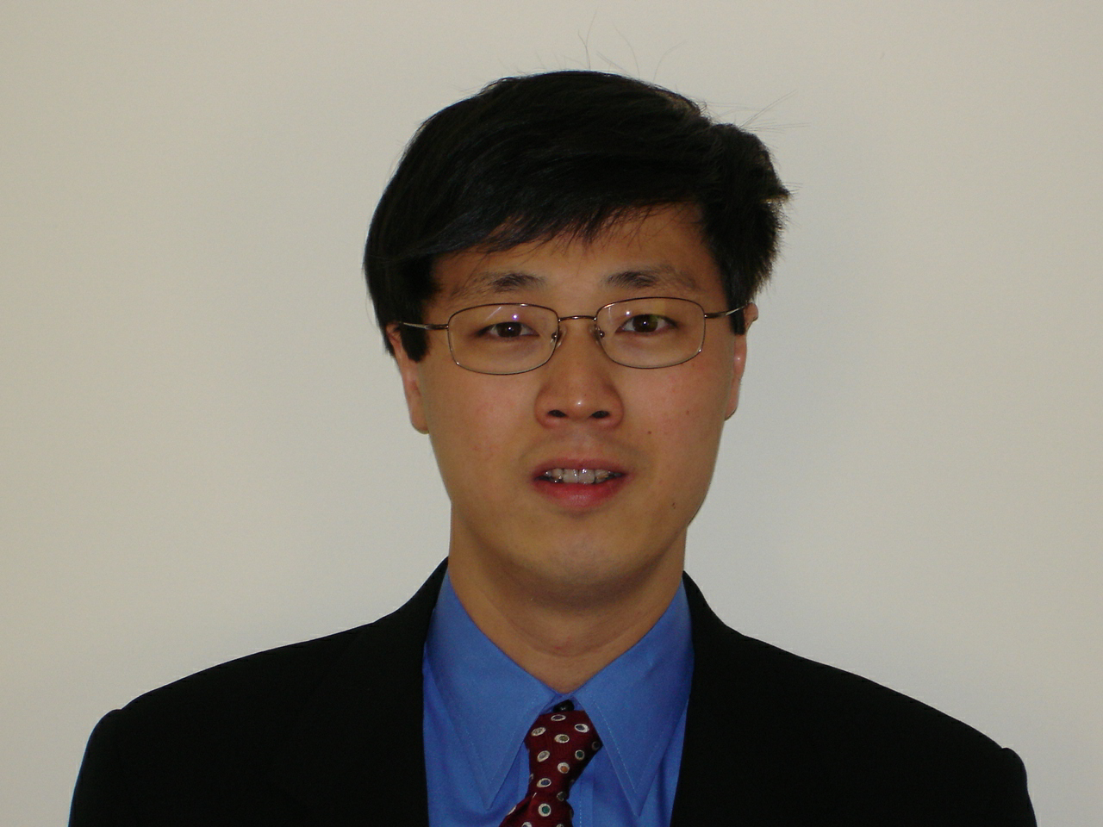
元素有机化学国家重点实验室
State Key Laboratory of Elemento-Organic Chemistry
Nankai University
学术报告
纪念陈茹玉院士诞辰100周年系列学术活动
报告题目：Development of Scalable and Cost-Effective API
Synthesis through Chemical Innovation
报告人：Dr. Jeff Song
Vice President
Chemical Development US
Boehringer Ingelheim Pharmaceuticals, Inc.
报告时间：2019年6月21日 上午10:00
报告地点：元素所石先楼学术报告厅
Dr. Jeff Song received his undergraduate education at Nankai University (南开大学) in Tianjin, China (1989 to 1992). After a brief stay at Rice University in Houston, TX, he moved to the Massachusetts Institute of Technology in 1993 and obtained his Ph.D. degree in 1998 under the supervision of Prof. Satoru Masamune. Subsequently, he joined the Department of Chemical Development at Boehringer Ingelheim Pharmaceuticals in Ridgefield, CT as a Senior Scientist. In the ensuing years, Dr. Song has achieved a series of promotions to Senior Principle Scientist up the scientific ladder followed by promotions to Director of Process Research on the managerial track. In 2018, Dr. Song was appointed the Vice President and Dept. Head of Chemical Development in the US overseeing all functions including Process Research, Flow Chemistry, Catalysis, Analytical Research, Radiosynthesis, Kilolab, Pilot Plant and External Chemistry Management. Dr. Song is recognized as a leader in the field and has published >110 research papers, review articles, patent applications and book chapters including some “Most-Cited” and “Most-Accessed” papers.
欢迎各位老师同学积极参加！

